Slide 1
Marketing and Retail Analytics Business Report
Authored by
Kartik Trivedi
24 Oct’, 2024

Slide 2
Problem A Agenda The objective of this analysis is to provide an automobile parts manufacturing company suitable insights about their customers using which they can target different segments of customers through tailored marketing strategy.
Executive Summary
Through our comprehensive analysis, we have successfully segmented customers into four distinct clusters. Cluster_0 represents our most valuable and loyal customers, while Cluster_3 comprises customers we have lost. Based on these findings, we propose the following recommendations.
Customers with a high RFM score, classified as the best customers, fall into Cluster_0. Special attention should be given to this group to ensure their satisfaction. Offering exclusive privileges or personalized incentives could further enhance their loyalty and engagement with the company.
There are some customers who make most of there purchases from the company only and have high recency and frequency score. These customers are very loyal and to reward them a special membership program could be designed which could include benefits like special discounts or express delivery.
There are customers who lie in cluster_1 and cluster_2 who have high frequency and monetary score but their recency score is low, it is recommended that a reach out drive is carried out to get in contact with these customers as these customers are at risk of churning, additionally, some special schemes could be run to attract back these customers.
Customers in cluster_3 have very low RFM score and it is recommended that resources are not wasted on these customers as cost incurred to get them back onboard could exceed the business they bring.

Slide 3
Table of Contents
Details
Data Overview
Exploratory Data Analysis
RFM Analysis
Inference
Slide Numbers
4 – 7
8 – 31
32 – 36
37 – 40

Slide 4

Data Overview
Shape of Dataset
Dataset has 2747 rows and 20 columns.
Data Information
12 columns have object type, 7 have numeric and 1 has datetime datatype.

Slide 5
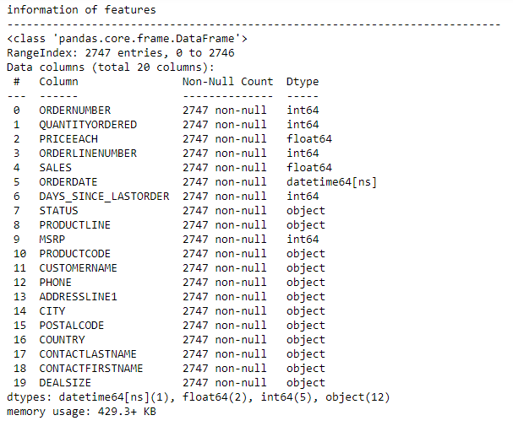

Slide 6
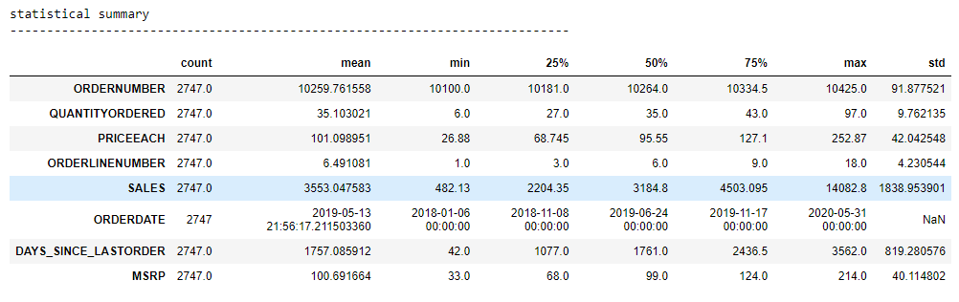
Statistical Summary

Slide 7
Key Observations
There are 2747 rows and 20 columns in the dataset.
Last order date in the dataset is 06 May 2020. For our analysis we will take 30 June 2020 as current date which is the end of quarter 2, 2020.
In 20 columns, 12 are object type, 7 are numeric and 1 is date time.
There are no missing value or duplicates in the data.

Slide 8
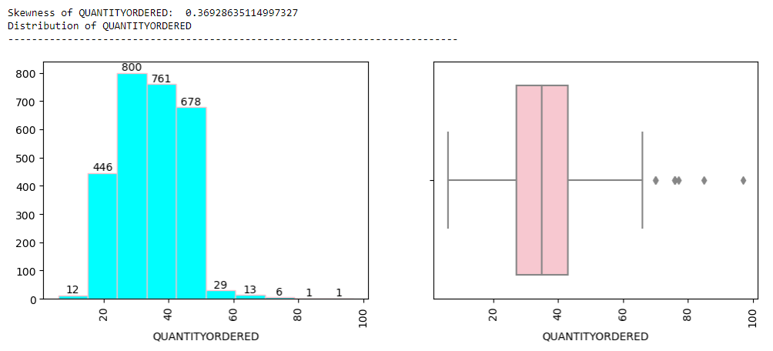
Exploratory Data Analysis Univariate Analysis For Numeric Columns

Slide 9
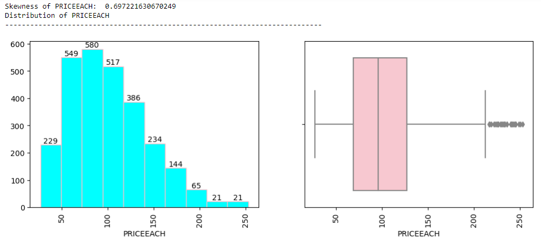

Slide 10
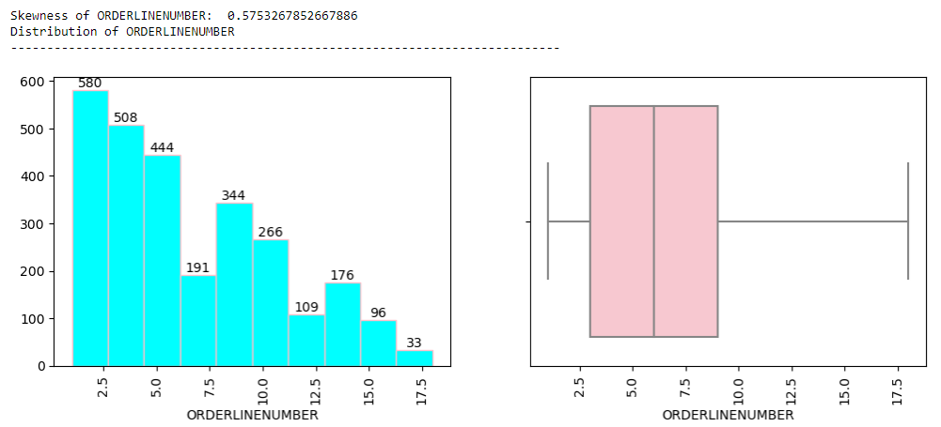

Slide 11
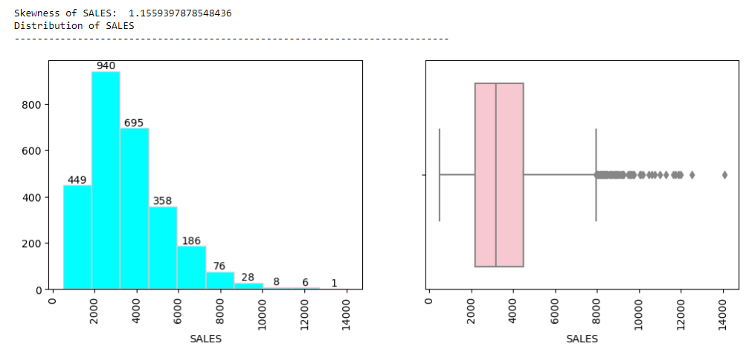

Slide 12
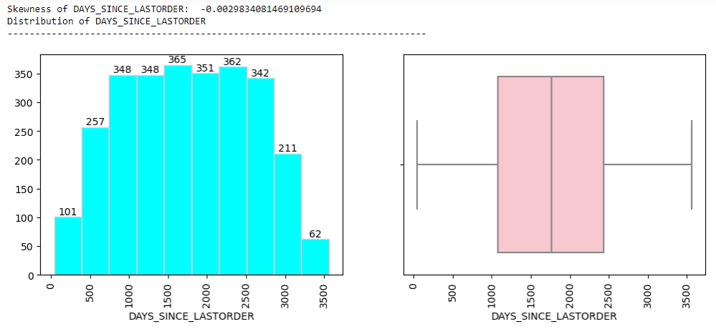

Slide 13
Key Observations
For most items quantity ordered is between 20 and 50.
Price of each unit for most products ordered is between 50 and 140.
Most customers order up to 6 products in a single order.
Sales value for most products ordered is between 2000 and 4000.
Reordering time for customers is very high ranging from 500 to 3000 days.

Slide 14
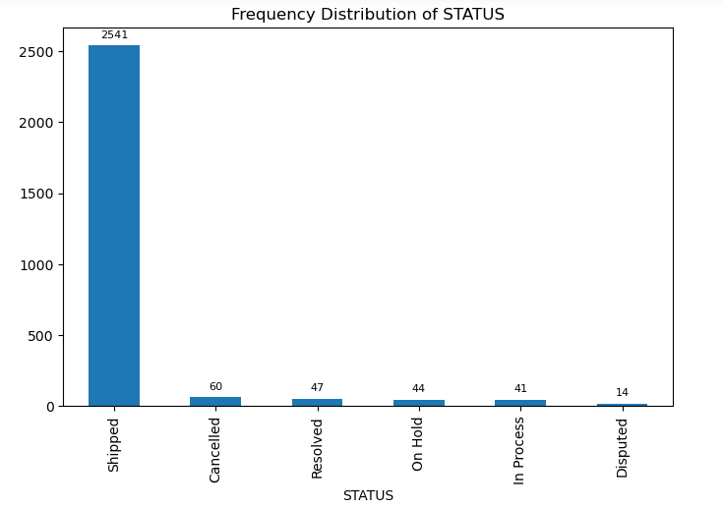
For Categorical Variable

Slide 15
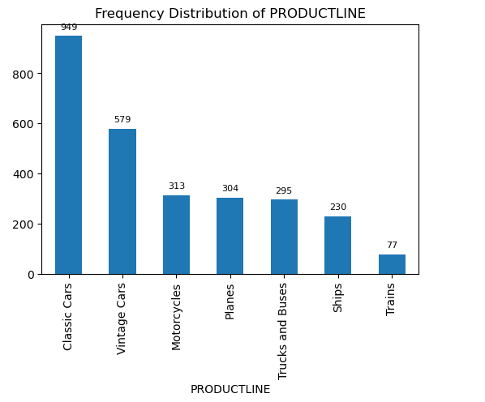

Slide 16
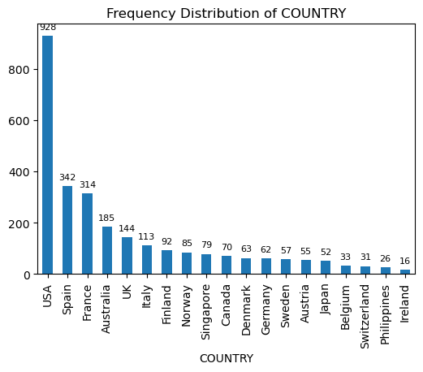

Slide 17
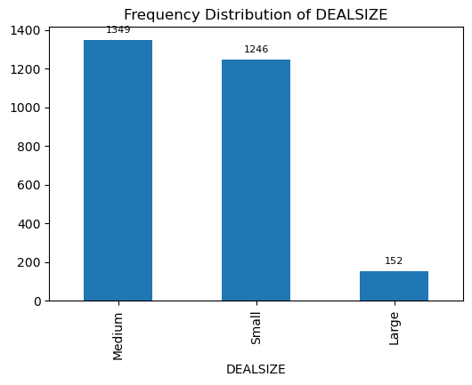

Slide 18
Key Observations
Order status for some orders are cancelled, On Hold or Disputed. For RFM analysis we will also include the orders whose status is cancelled, On Hold or Disputed.
Most items sold are for Classic cars and Vintage cars category.
In country terms USA is biggest source of business.
Most deals are medium sized which is good, however, there are very few large deals.

Slide 19
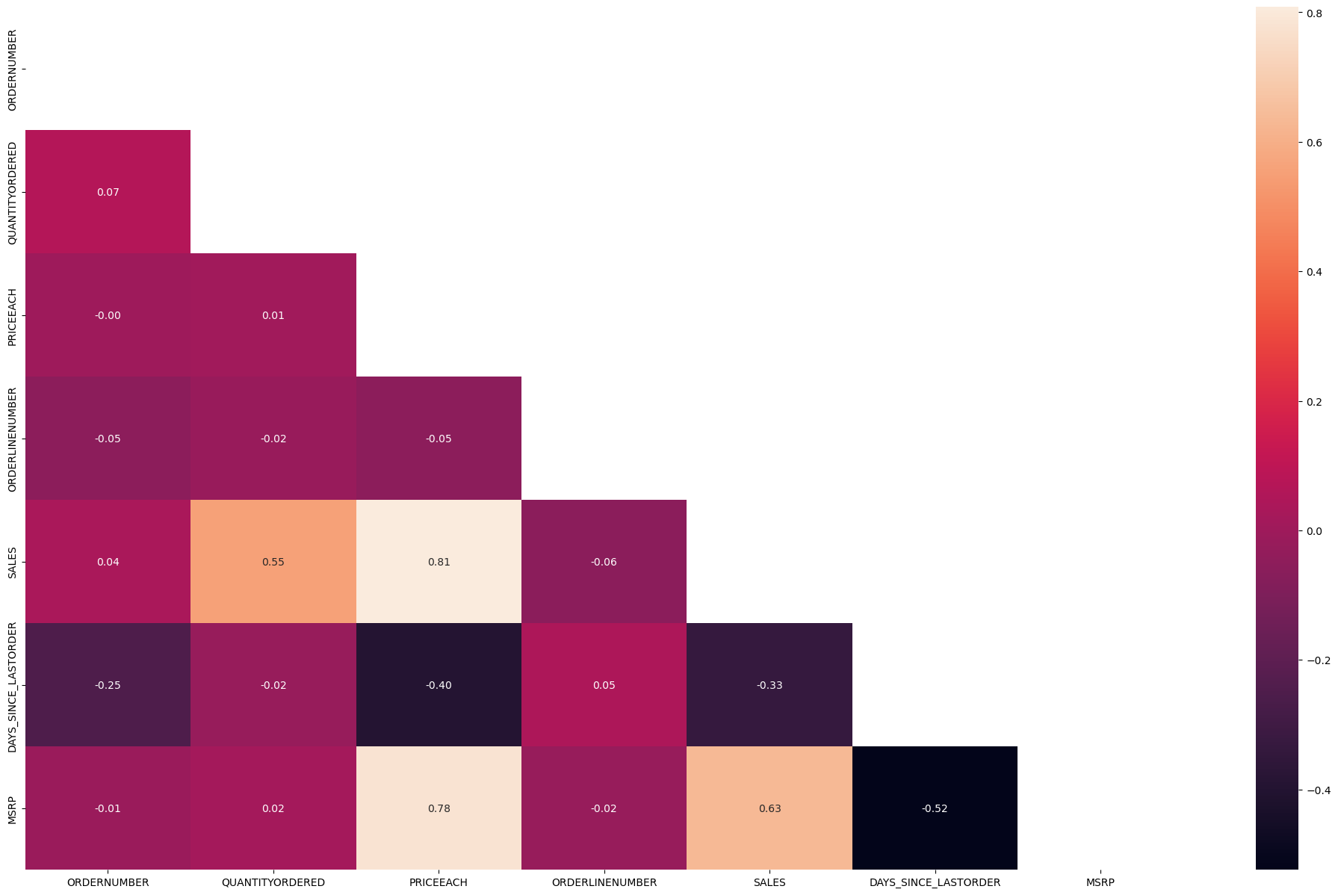
Bivariate Analysis Between Numeric and Categorical Variables

Slide 20
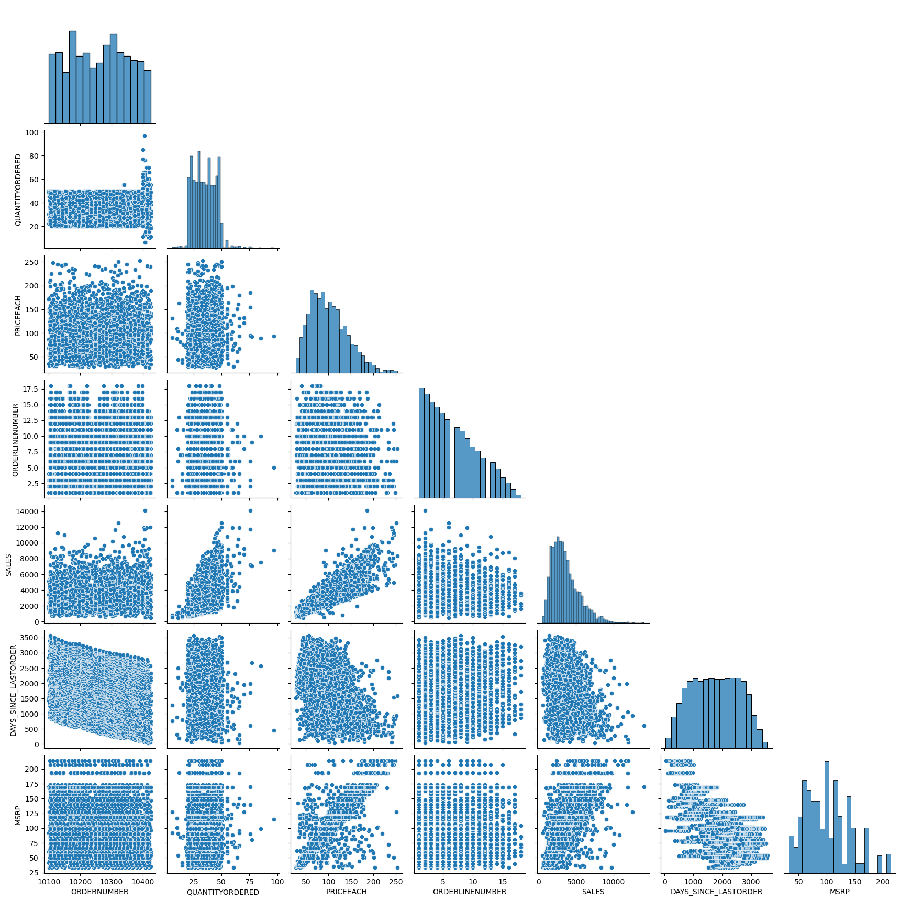

Slide 21
Key Observations
While there is significant correlation between some expected attributes like Sales, MSRP, Price Each and Quantity Ordered, there is significant inverse correlation between Days Since Last Order and MSRP meaning as purchasing frequency increases for a customer they purchase more expensive products.

Slide 22
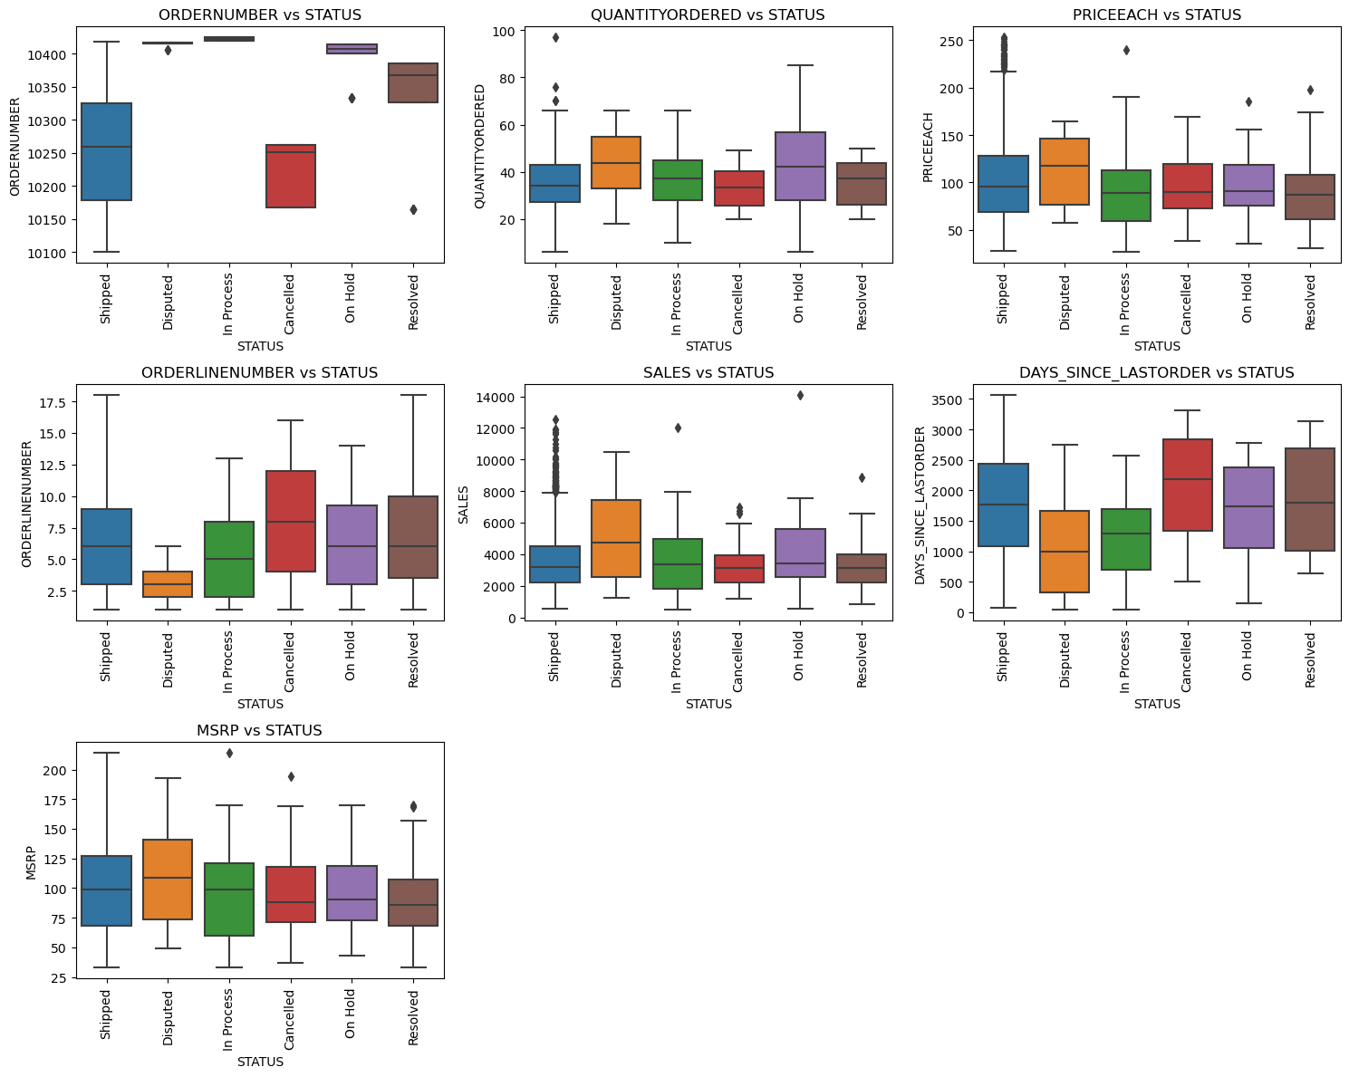
Between Numeric and Categorical Columns

Slide 23
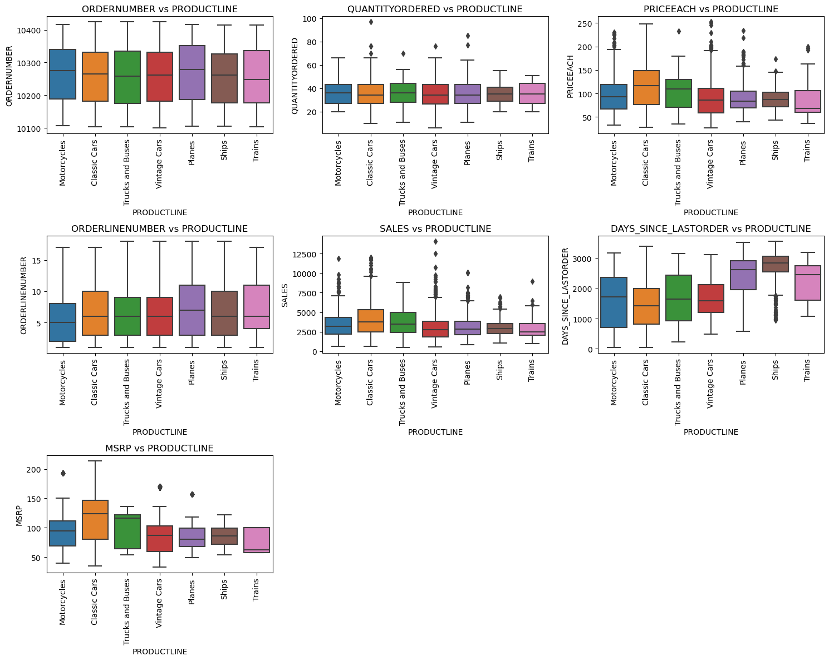

Slide 24
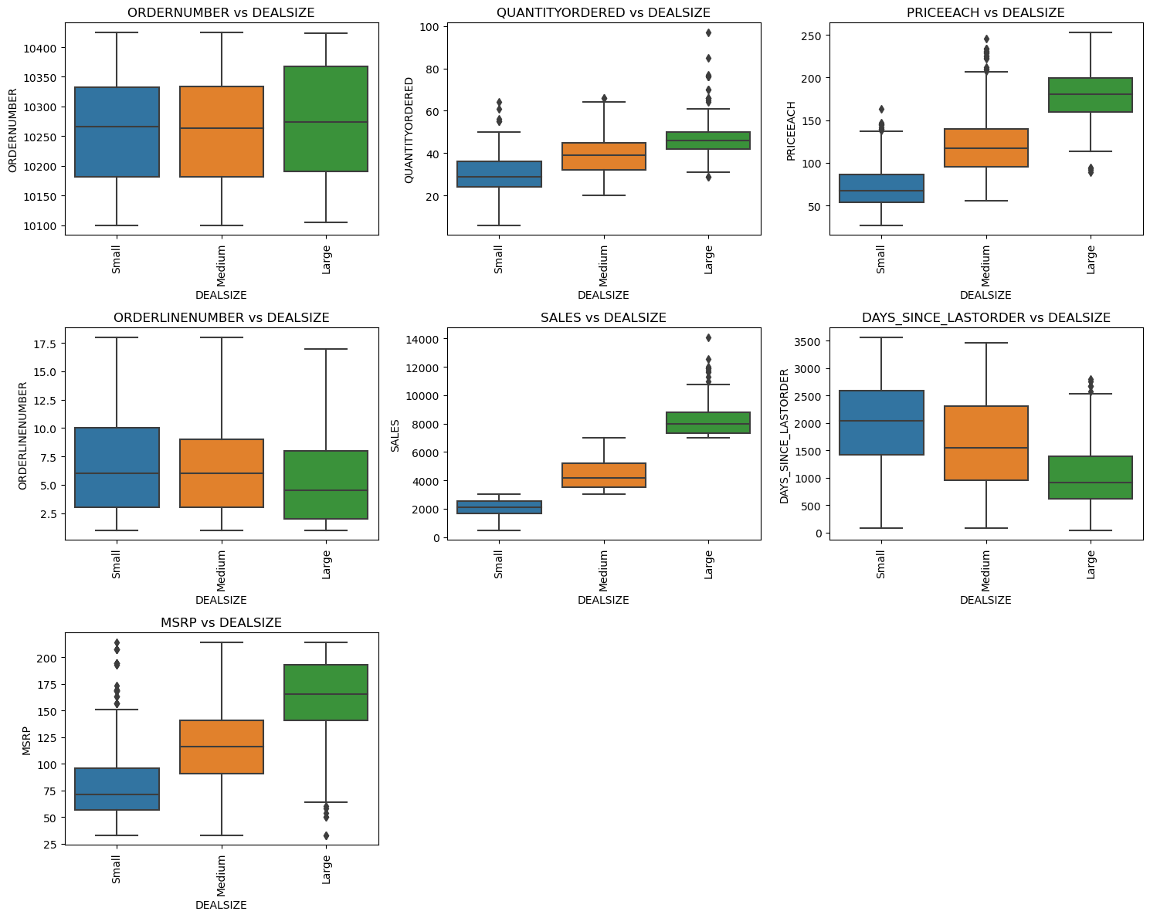

Slide 25
Key Observations
Most of the cancelled orders are associated with lower order numbers, while resolved orders are tied to higher order numbers, indicating that recent order disputes are being resolved.
Disputed and on-hold orders tend to have higher quantities and values, requiring careful attention in dispute resolution.
Among product lines, classic cars outperform others in terms of product pricing and overall sales value.
Larger orders typically involve higher-priced products and show a shorter time gap between the previous order and repeat orders.

Slide 26
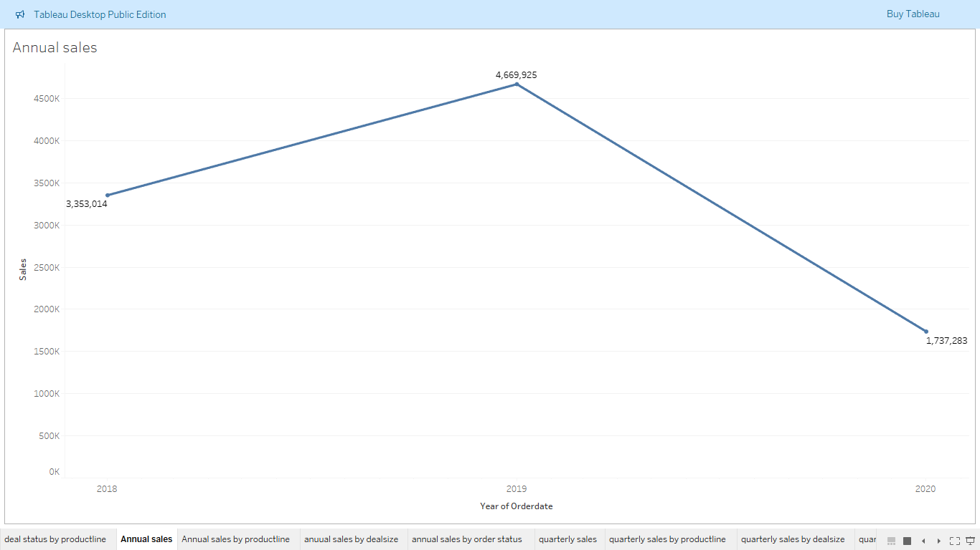
Multivariate Analysis

Slide 27
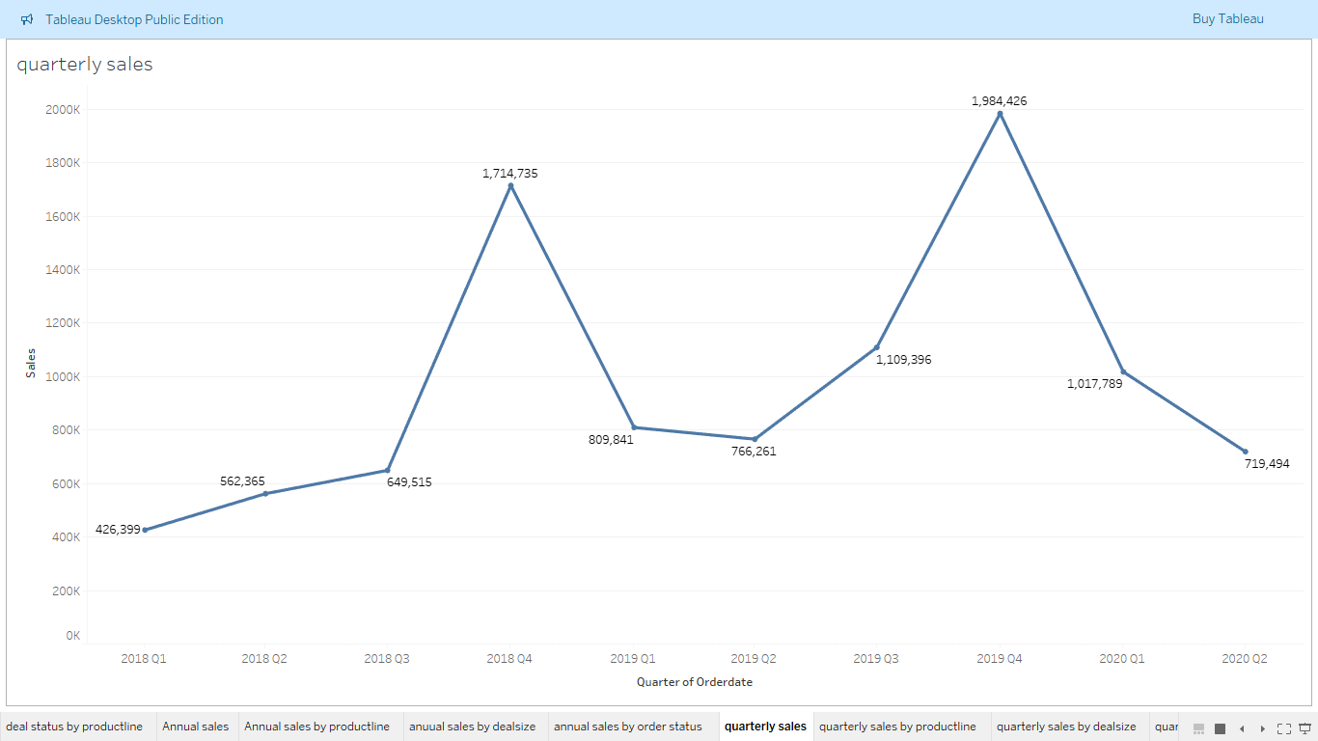

Slide 28
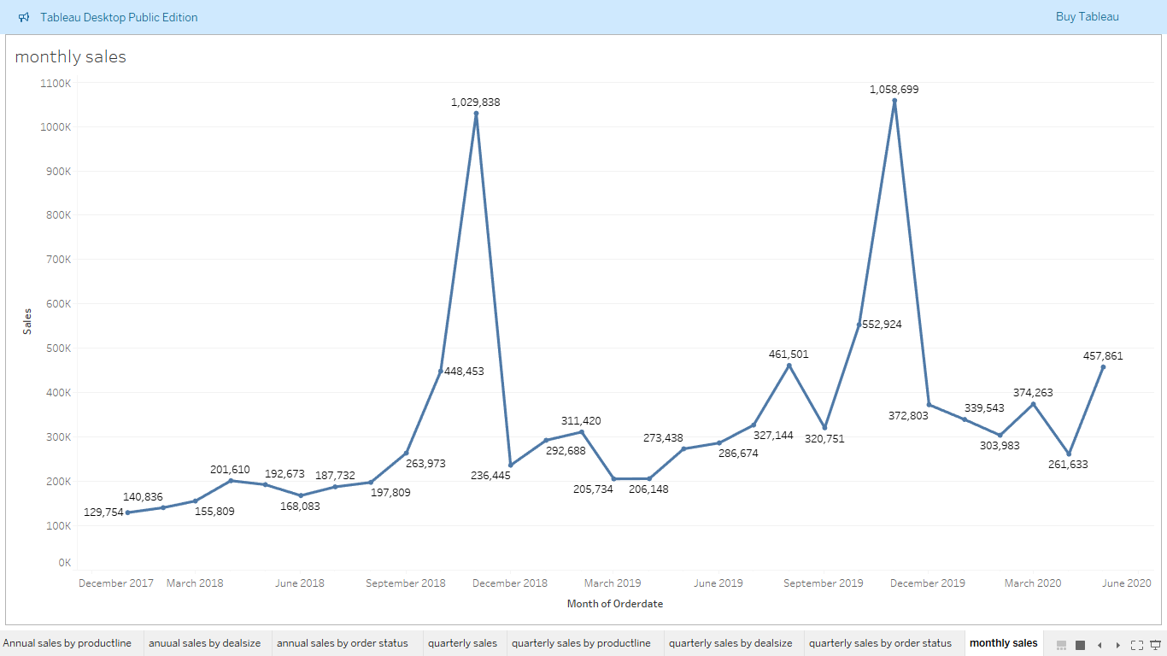

Slide 29
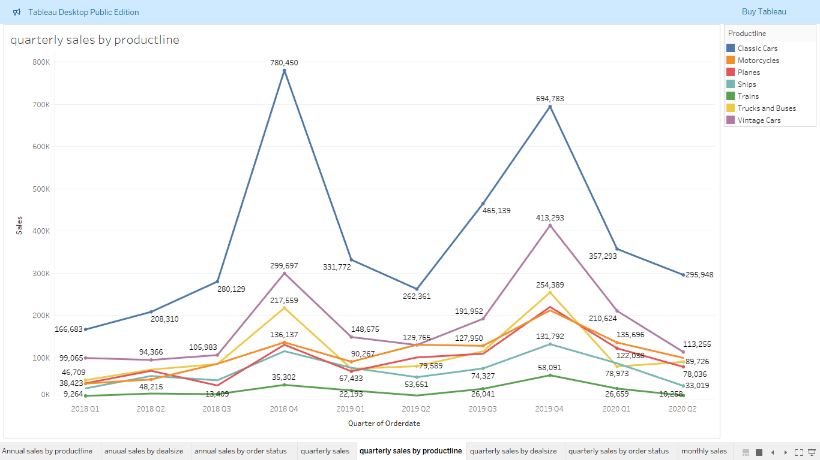

Slide 30
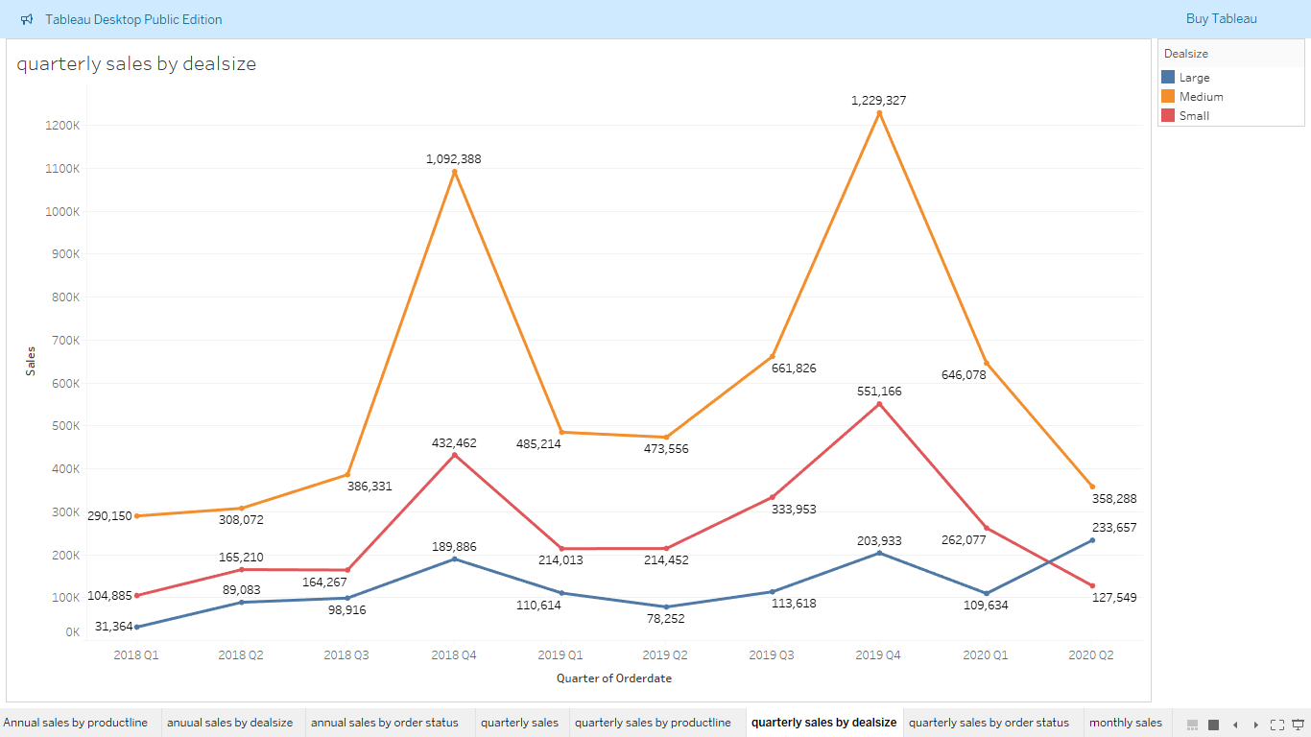

Slide 31
Key Observations
On year-on-year basis sales is showing an upward trend.
On quarterly and monthly basis there is a clear seasonality with sales where on quarterly basis sales tend to grow in Q3 and peak out in Q4 while on monthly basis there is a clear peak formation for the month of November.
All product line have the seasonality effect though this effect is more profound for product line with high sales like classic cars and vintage cars.
Seasonal trend is also observed in deal type where all three types show similar trends.

Slide 32
RFM Analysis: Understanding Customer Value
What is RFM?
RFM (Recency, Frequency, Monetary) analysis is a customer segmentation technique used to identify and prioritize valuable customers based on their purchasing behavior.
Helps businesses optimize marketing efforts by targeting customers based on how recently, frequently, and how much they spend.
Parameters:
Recency (R)
Time since the last purchase.
Assumes recent customers are more likely to engage again.

Slide 33
Frequency (F)
Number of purchases within a specific period.
Assumes frequent buyers are more loyal.
Monetary (M)
Total spending within a period.
Assumes high spenders provide more value.
Assumptions in RFM Analysis:
Higher Scores = Higher Value: Customers with high scores are more valuable.
Segment-Based Targeting: Assumes customer groups (e.g., recent vs. lost) have distinct engagement potential.
Temporal Relevance: More recent behaviors predict future buying better than older data.

Slide 34
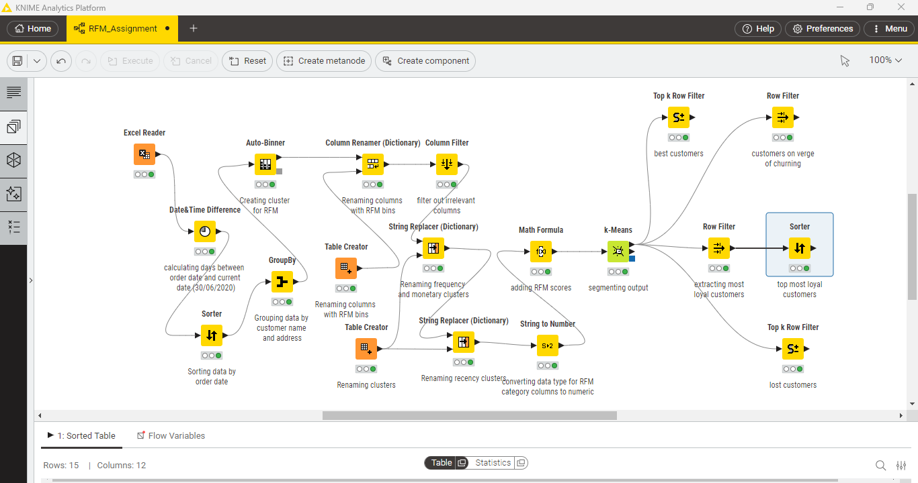
KNIME Workflow

Slide 35
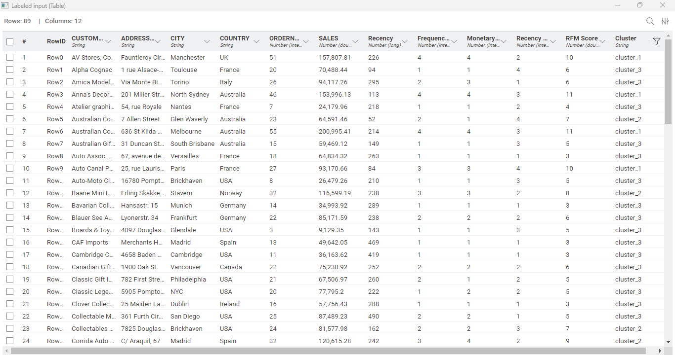
RFM Analysis Output Table

Slide 36
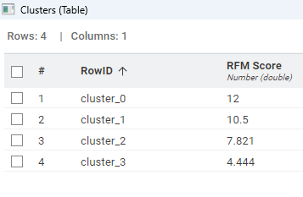
Identified Segments
Customers with total RFM score of over 10.5 are in first cluster, greater than 7.821 in second, above 4.444 in third and less than equal to 4.444 in fourth.

Slide 37
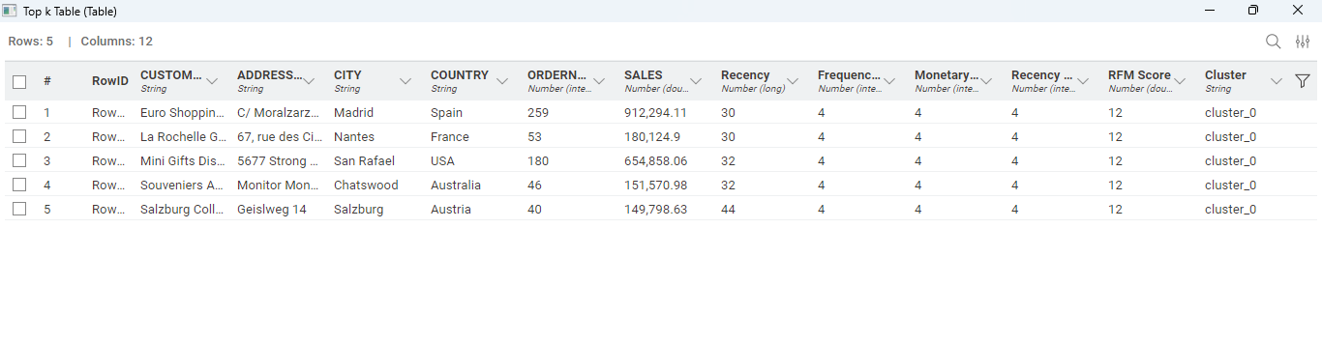
Conclusion Best Customers
These are our best customers who bring most business to the company. It is highly recommended that special attention should be given to these customers and any related to these customers should be dealt with utmost priority.
Additionally, some benefits like special discounts can be provided to these customers to ensure that they are satisfied.

Slide 38
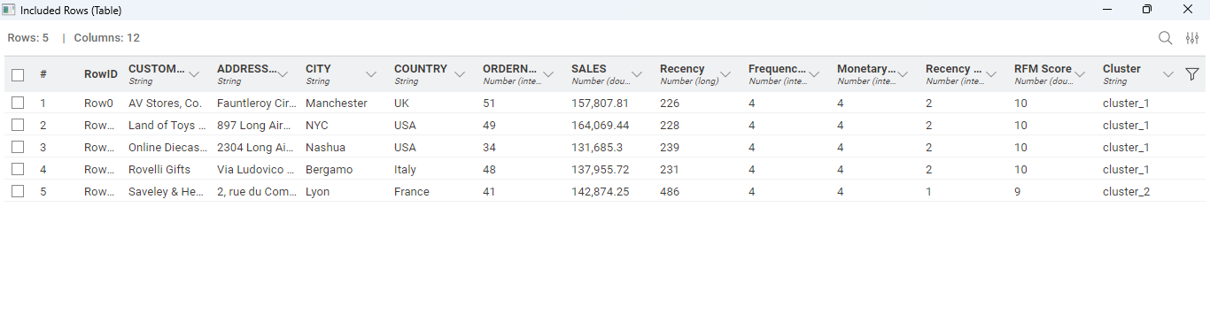
On verge of Churning
These customers used to make frequent purchases with good ticket size, however, they have not made any purchases in some time, we are at risk of loosing these customers.
It is recommended that sales team gets in touch with these customers and some campaigns could be run to win back these customers.

Slide 39
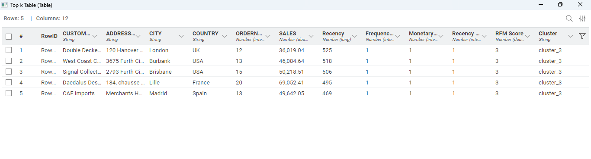
Lost Customers
These customers have not placed any orders in long time, additionally, their purchase frequency and bill amount are also very low.
We consider these customers as lost customers and even if we loose these customers the impact would be insignificant thus it is recommended that not a lot of effort should be made to get back these customers.

Slide 40
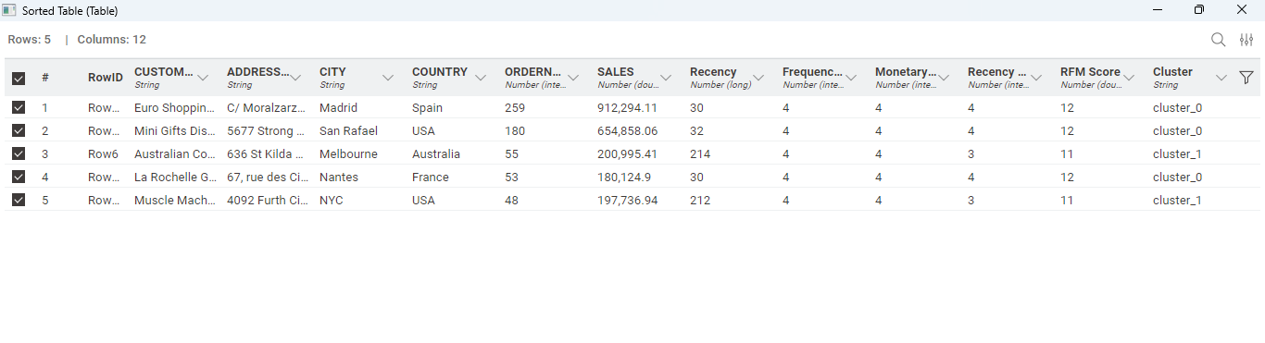
Most Loyal Customers
These are the most loyal customers as they make purchases very frequently and bring in good business.
It is recommended that a special loyalty program could be designed for these customers wherein some benefits are passed to them including special discounts or faster delivery etc.

Slide 41
Problem B Agenda The objective of this analysis is to study the point of sales data for a grocery store in-order to identify the products which are frequently bought together by customers as the store plans promotional activity around this insight to drive up its revenue.
Executive Summary
Following the market basket analysis, we have identified approximately 50 key associations at support of 0.175 and confidence value of 0.4 wherein the lift value for each association is over 1. However, some of these may be less relevant due to differences in product categories or specific conditions required for their storage. Considering these factors, the most significant and appealing offers could include the following:
On purchase 1 dozen eggs a soda bottle could be given free.
Creating a discount combo for juice and yogurt.
Creating a discount combo individual meals and lunch meat.
Creating a combo for poultry and mixes.
Creating a discount combo for lunch meat and poultry

Slide 42
Table of Contents
Details
Data Overview
Exploratory Data Analysis
RFM Analysis
Conclusion
Slide Numbers
43 – 44
45 – 52
53 – 57
58 – 61

Slide 43

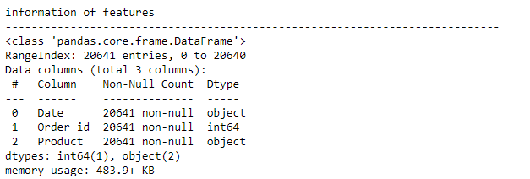
Data Overview
Shape of Dataset
Dataset has 20641 rows and 3 columns.
Data Information
2 columns have object type and 1 have numeric datatype.

Slide 44
Key Observations
Dataset has 20641 rows and 3 columns.
There are no missing values in the data.
There are duplicates in the data which when doing market basket analysis, we will convert it to set.
There are over 30 unique products being sold by the grocery store, for EDA we will segment these products into 5 categories and will perform the analysis based on these categories.

Slide 45
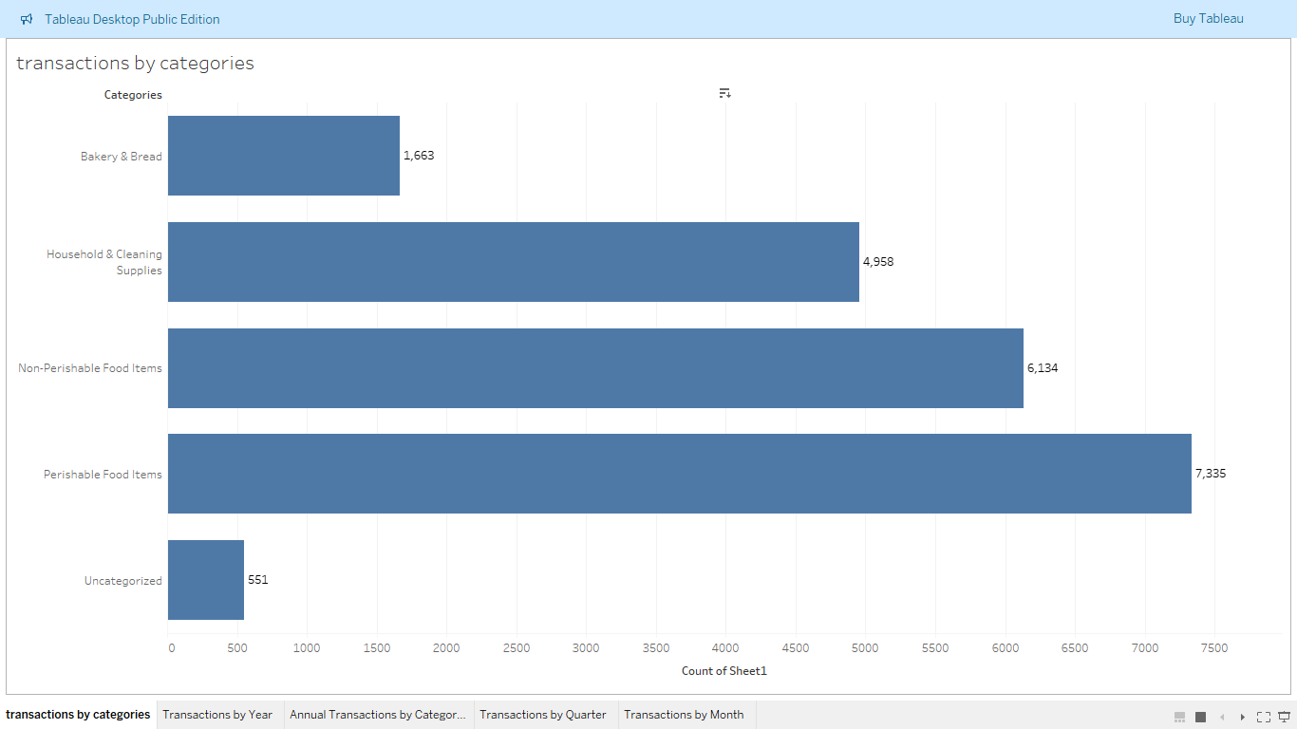
Exploratory Data Analysis Univariate Analysis For Product Categories

Slide 46
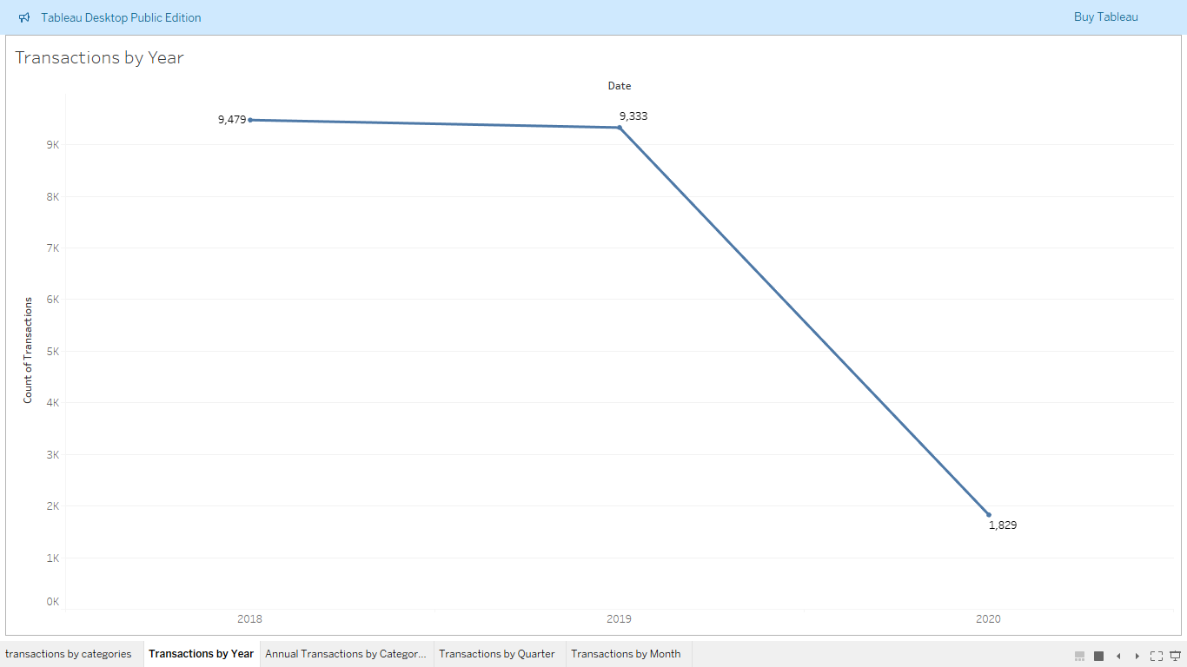
Bivariate Analysis Between Product Category and Date

Slide 47
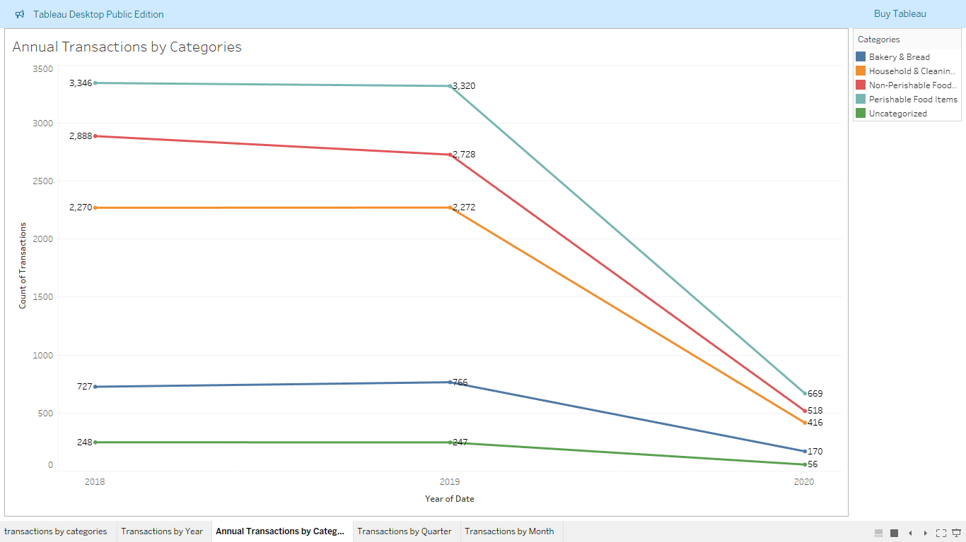

Slide 48
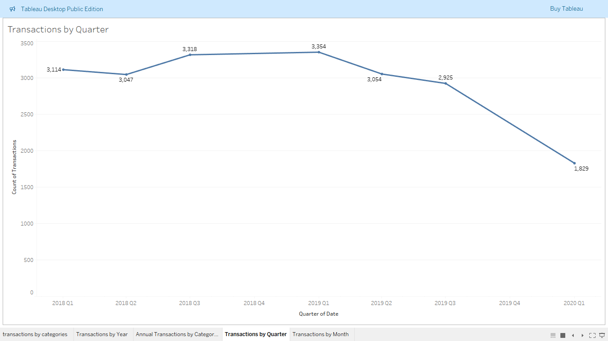

Slide 49
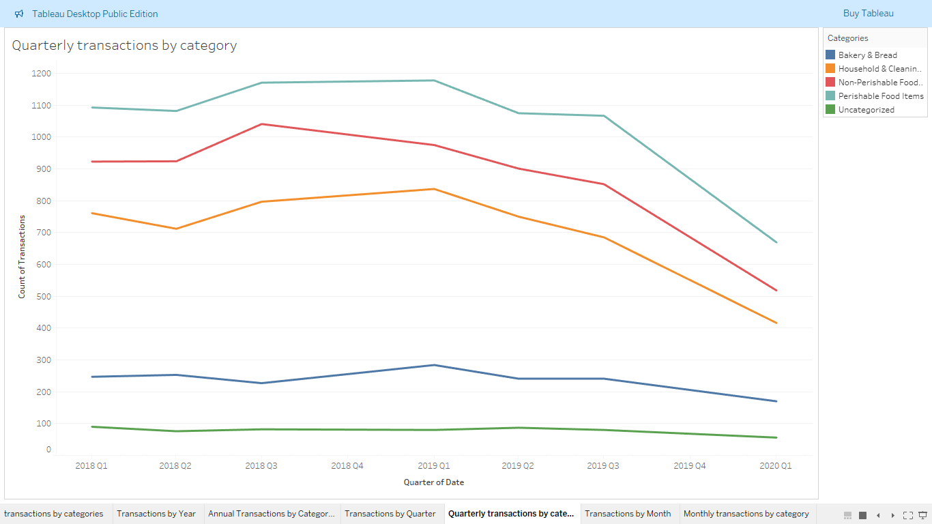

Slide 50
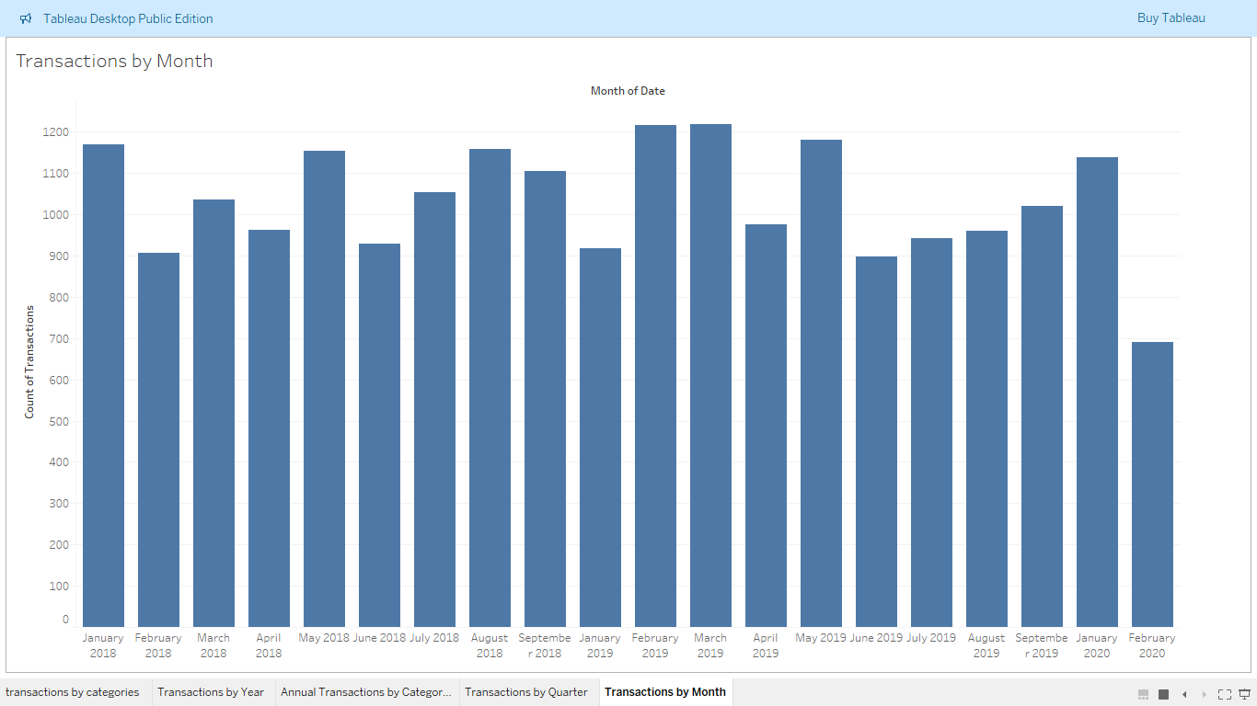

Slide 51
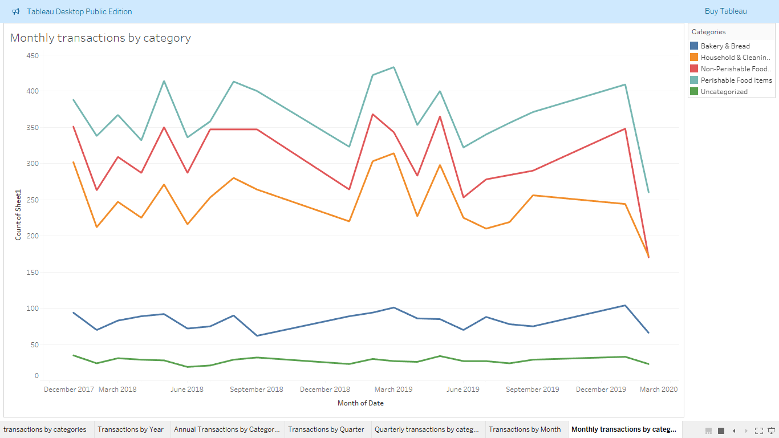

Slide 52
Key Observations
Perishable and non-perishable food items have highest number of transactions.
In year-on-year terms, sales have remained constant and this trend is consistent when observed for all the categories.
On granulating the data further in quarterly and monthly terms there are no transactions for three months of fourth quarter.
In monthly data though category wise sale remain within a range for each category, there are fluctuations in number of transactions when compared on month-on-month basis.

Slide 53
Market Basket Analysis Association Rules in Market Basket Analysis
What Are Association Rules?
Association rules help identify relationships between items that frequently occur together in transactions. It answers the question: "If a customer buys item X, how likely are they to buy item Y?"
Key Metrics:
Support: Frequency of item(s) appearing in transactions.
"X is purchased in 30% of all transactions."
Confidence: Likelihood of purchasing item Y when X is bought.
"If X is purchased, Y is also bought 70% of the time."
Lift: Strength of the association between X and Y compared to random chance.
"Lift > 1 indicates X and Y are positively correlated."

Slide 54
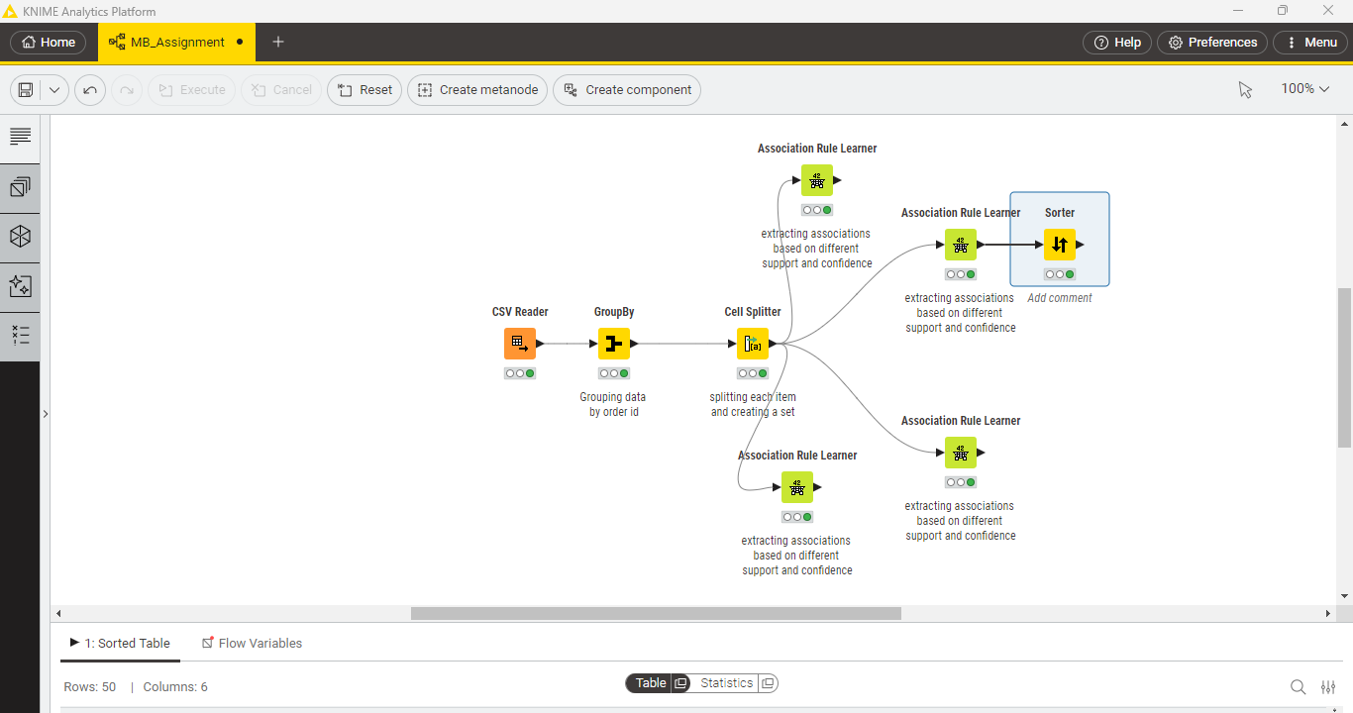
KNIME Workflow

Slide 55
Value for Support and Confidence
For grocery business normally value for support remains at around 0.15, taking this into consideration we created association rules using different value of support and kept confidence level at 0.25.
On trying different values of support we found that at 0.175 the number of associations were 50, on lower values combinations available were too high and on higher value there were not enough meaningful associations.
We increased the confidence level to 0.4 after finding the optimum support level at 0.175 as having a confidence level of over 0.4 means that at least 40% of customers purchasing product A will also purchase product B. This combination is significant and will help create impactful combos and offers as well lead to optimum use of floor space available.

Slide 56
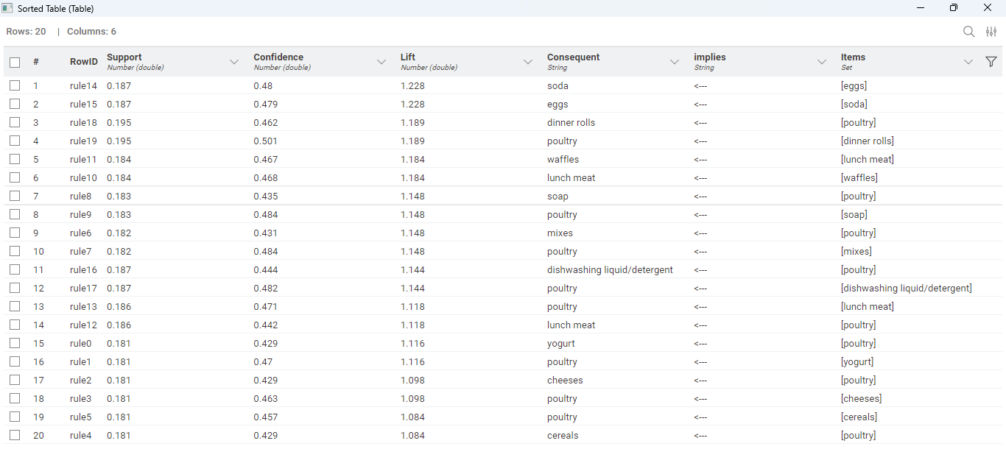
Associations Identified

Slide 57
Support, Confidence and Lift Values
Support: Support value is kept at 0.175, this means that of all the customers who are visiting the store at least 17.5% will purchase the item.
Confidence: Confidence is the measure of probability, it calculates the probability of purchasing the consequent item provided that a customer has purchased a item. Confidence level is at 0.4 meaning there is 40% probability that a customer will purchase the consequent item provided they have purchased an item.
Lift: In market basket analysis lift is an important metric it explains how strongly an item is correlated to the consequent item. In the association rules extracted lift is over 1 for each association meaning there is a positive correlation like for eggs and soda lift value is 1.228 meaning that if a customers purchases eggs their probability of purchasing soda increases by 22.8%.

Slide 58
Conclusion
Market basket analysis using different support and confidence value provided us with multiple association rules where these association rules could be utilized for two purposes.
Improving cross selling by strategically placing frequently co-purchased items and designing combos and customer offers.
Optimizing store layout by strategically place frequently co-purchased items

Slide 59
Offer Recommendations
Based on the market basket analysis we have been able to shortlist around 50 associations. However, there are some associations which might not be as relevant due to difference in categories they belong to or specific conditions n which they have to be kept in.
Taking the above factors into consideration some of the most significant and attractive offers could be:
On purchase 1 dozen eggs a soda bottle could be given free.
Creating a discount combo for juice and yogurt.
Creating a discount combo individual meals and lunch meat.
Creating a combo for poultry and mixes.
Creating a discount combo for lunch meat and poultry

Slide 60
Giving a pack of yogurt free on purchase of 2 packs of poultry.
Creating a combo for poultry and milk.
Creating a discount combo for cheese and poultry.
Creating a discount combo for eggs and poultry

Slide 61
Store Layout Recommendations
Support of 0.15 and confidence of 0.25 gave over 900 associations from which we can extract some key associations based on categories to strategically place these co-purchased products together.
Based on product categories some of the significant co-purchased products together in top 100 rules are:
Paper towels and sandwich bags
Mixes and flour
Aluminium foil and sandwich bags
Soap and shampoo
Sugar and pasta

